Slide 1
Communities of Practice
​
State Association Meeting
October 21, 2021
This project was funded in part by a cooperative agreement with the Centers for Disease Control and Prevention grant number 5 NU50CK000588-02. The Centers for Disease Control and Prevention is an agency within the Department of Health and Human Services (HHS). The contents of this resource center do not necessarily represent the policy of CDC or HHS and should not be considered an endorsement by the Federal Government.
Notes:
Hi everyone! I am excited to share with you what we have been doing and learning since the project activities began about four months ago.

Slide 2
Community of Practice (CoP)
Also described as ‘Peer Assist’
Comprised of individuals performing similar roles
Intent is to learn from one another, capture lessons
Generally include the same group of individuals but may shift and reconvene as needs and areas of interest are identified
Looking back – after action review; looking forward – diffusion of innovation

Slide 3
Community of Practice (CoP)
https://www.communityofpractice.ca/background/what-is-a-community-of-practice/
https://www.communityofpractice.ca/background/what-is-a-community-of-practice/

Slide 4
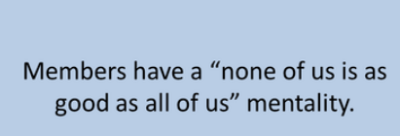
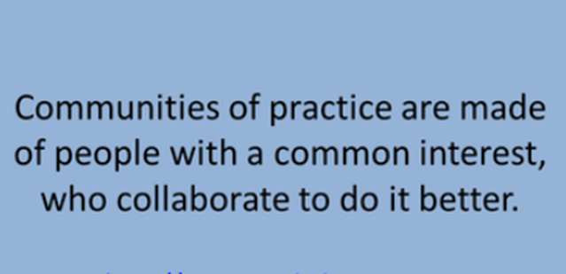
Community of Practice (CoP)
Communities of Practice: The Organizational Frontier by Etienne C. Wegner and William M. Snyder

Slide 5
Proposed Community of Practice (CoP) Pilot Clinic Level
Made up of individuals in similar roles within the FCCs
Starting with Clinical Directors
Groups may be of Doctors, Nurses, Front desk staff
Groups of 10-12 with a facilitator to keep to a schedule – same groups to meet over time
Initially groups will be drawn from within states but may see organic groups with a common interest (e.g. population base of a particular ethnic or religious background, rural in nature vs. urban)
Anticipate one meeting a month for an hour
Recordings will be used to extract information of value to the larger group (anonymized)
Americares’ role will be to synthesize the content, identify themes and disseminate knowledge
Agendas will be set by the participants for topics to be covered in subsequent sessions

Slide 6
Proposed Community of Practice (CoP) Pilot - Clinic Level
Initially will be holding CoPs with up to five states
Plan is to scale to include more participants.
Possibly changing demographic groupings depending on response and stated interest
Participants will be encouraged to identify topics for discussion at future sessions
Participants are encouraged to collaborate outside of the CoPs
Request of the State Association
Recruit Clinic Directors from within your State Association who would benefit from the opportunity to learn from one another and who would be willing to share their expertise

Slide 7
Timeline COP Pilot - Clinic Level
November 2021
January 2022
March 2022
May 2022
Pilot Stage – Clinic Directors
Florida
Georgia
Idaho
Stage 1
3-5 more states
Stage 2
3-5 more states
Stage 3
Remaining States
Other COPs as necessary (ex. Health providers)

Slide 8
State Association Community of Practice
Building on these meetings…
Knowledge Sharing at the Association Level
Tools
Conventions
Incentives
Replacing existing Program Meeting
No additional meetings
Once a month
Gives an opportunity to share and document learning.

